Slide 2
Ms. Jane Weir
Santiago School for 9 years
19 years with SAUSD
I’ve taught Kinder, 1st grade, 4th grade and 5th grade
I LOVE KINDER!!

Slide 3
8:00-9:35 Lang.Arts:Phonics/Reading/Writing/Social Studies
9:35-9:55 Snack/2nd Chance Breakfast & Recess
10:00-10:15 Rest/Music Read Aloud
10:15-11:00 Math Lesson/ Math Groups/ ST Math
11:00-11:45 Lunch & Recess
12:00-1:35 Science/Social Studies/Art
135-1:50 Clean Up, Pack Up, Line Up
1:55 Dismissal
*Drama, weekly *Computer Lab 2xs/week
*STEAM LAB weekly *Library Weekly

Slide 4
LANGUAGE ARTS
Reading Standards: Upper & Lower Case Letters
Letter Sounds
Blends Sounds in Spoken Words
Reads Sight Words
Writing: Writes Opinion, Informative & Narrative
Pieces using drawing & writing
Language: Prints Upper & Lowercase Letters
Writes most letter sounds to make simple
words
Uses correct grammar in writing &
speaking

Slide 5
LANGUAGE ARTS THEMES
UNIT 1: Rules at Home and School
UNIT 2: Every Story Has Characters
UNIT 3: Plants & Animals Have Needs
UNIT 4: Writers Tell Many Stories
UNIT 5: Technology at Home & School
UNIT 6: Stories Have a Message
UNIT 7: Holidays and Celebrations
UNIT 8: Weather & Seasons
UNIT 9: Meeting Our Needs & Wants
UNIT 10: Forces & Motions

Slide 6
MATH CONCEPTS
Grade K students should master:
Counting to 100 by ones and tens
Writing numbers from 0-20
Counting, 1:1 correspondence
Decomposing numbers to 10
Fluently adding and subtracting
within 5

Slide 7
MATH CONCEPTS
Grade K students work towards fluency in:
Place Value 11 to 19
Understanding addition and subtraction
Grade K students are introduced to:
Addition and subtraction word problems
Measurable attributes, such as length or
height
Classifying objects into categories
2D (flat) and 3D (solid) shapes
Comparing, creating, and composing shapes

Slide 8
Computer Lab: 2 times a Week
iPads in our Classroom, 1 to 1
LEXIA Reading Program
ST Math
Our Class Goal is to complete both programs by mid May
https://www.sausd.us/domain/7480

Slide 9
Monthly Packet:
* ½ pg-one pg daily
*parent initial weekly
*teacher initial weekly
*turned every Friday
Homework should take 10 min, plus 10 min of parent reading. Write the
title of the book on the reading log.

Slide 10
Students need to bring a folder to school everyday.
Monthly Homework Packet is due every Friday.
Friday Flyers- I will be collecting all flyers throughout the week and sending them home on Friday, with exception to time sensitive informative flyers

Slide 11
Golden Rule:
Treat Others as You Want to be Treated
*warnings (always)
*teachable moments

Slide 12
Buggy Behavior
for Individual Behavior
All students start on Purple leaf and progress down and back up based on behavior. Red pot earns brief (2-5min.) time out.
Students on purple or blue leaf receive sticker at end of day

Slide 13
Potato Head Party
(whole group behavior)
When all students are collectively behaving well. They earn a part of Mr. Potato Head. When Mr. Potato Head has all his parts, the class is rewarded with a learning movie or Go Noodle (dance party) and potato chips, graham cracker or other similar type snack.

Slide 14
PBIS
Positive Reinforcement
Turtle Dollars
Turtle Store
Santiago Scholars are Ready, Responsible, Respectful.

Slide 15
CLASS DOJO
Please sign up for the app. I shar share photos, school events, donation
request, ect. Class Dojo has a message
center, making communication easy simple.
Message me anytime!
*please do NOT re-post photos on social media
https://teach.classdojo.com/#/classes/5d48d734beba81e8cc85998c/story

Slide 16
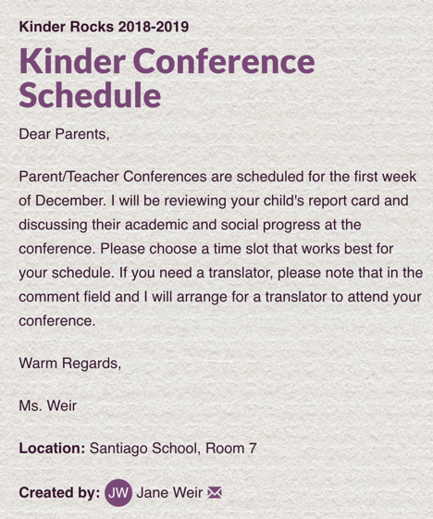
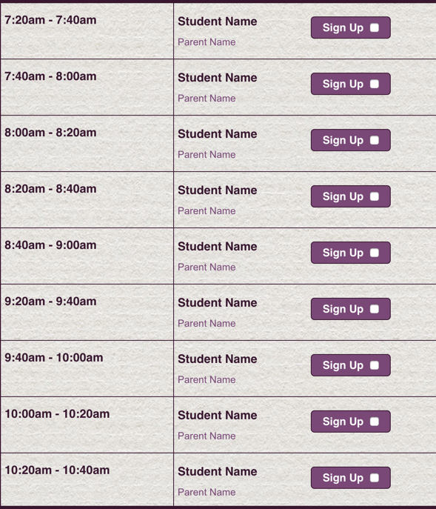
SIGN UP GENIUS
A tool for scheduling conferences & volunteers and dontation requests: please click the link
https://www.signupgenius.com/go/5080a44afad2da0fc1-1sttrimester

Slide 17
Student Donation:
Headphone for your child compatible with iPads
Classroom Donation Items: hand sanitizer, wet wipes, baby wipes, paper towels, Kleenex tissues, baggies and graham crackers for Potato Head party
https://www.signupgenius.com/go/5080A44AFAD2DA0FC1-classroom

Slide 18
Progress Report Cards Sept 20
Veterans Day Nov. 11th
Student Free Day Nov. 22th
Thanksgiving Week Nov. 25th-29th
Parent Teacher Conferences:
Nov 18th-21st (student free 11/22)
Drama Performance:
12/19/19 at 1:15pm & 3/13/20 at 1:25pm

Slide 19
Sign Up for the PTA Membership
The PTA provides assemblies, arts enrichment programs. This year the PTA will host the following programs:
Art Masters Legacy - Lichtenstein, Sept.6-11
Imagination Machine - Who,What, Where/Write Away, December 3-4 (K-8)
Imagination Machine - The Writing Show, February 20 (K-8)
Art Master Legacy - Wright, March 9-12 (K-5)
**Our class goal is 100% membership by end of September.**

Slide 20
HANDOUTS
Kinder sight words
September Homework Packet
Volunteer Forms
Student Handbook, sign
& return insert located
between pgs 40-41

Slide 21
Volunteer Opportunities
https://www.signupgenius.com/go/5080a44afad2da0fc1-volunteer
Child Creativity Project: October 8th 8:00am-9:30am
4 parents needed, STEAM Lab
Drama Class: Wednesdays: 10:00am-10:25am
Drama Performances: 12/19/19 & 3/13/19
Computer Lab: Monday & Friday at 11:45-12:30
STEAM LAB: Tuesdays 8:30-9:00am
Home Projects: As Needed
*Complete SAUSD Volunteer Form

Slide 22
Sign Up Genius
Conference Schedule Sign Up https://www.signupgenius.com/go/5080a44afad2da0fc1-1sttrimester
Donation Sign Up
https://www.signupgenius.com/go/5080A44AFAD2DA0FC1-classroom
Volunteer Sign Up https://www.signupgenius.com/go/5080A44AFAD2DA0FC1-volunteer

Slide 23
SANTIAGO SCHOOL PRIDE
COLLEGE WEDNESDAY
SAUSD and Santiago School encourage all students to prepare for a college education. Each classroom has a adopted a university. Our class has adopted Texas University. Home of the Long Horns! You can purchase a college tee for $10. Students can wear their Texas tee shirt every Wednesday.
SANTIAGO SPIRIT FRIDAY
PTA is selling Santiago Spirit tee shirts for $10. Students are encouraged to wear
show their school pride by wearing their Santiago tee every Friday.
DRAMA DEPT.
The Drama dept. is also selling spirit tee shirts FOR $10.
Students may wear their Santiago Drama tee shirt any day
of the week.

Slide 25
Jane.Weir@sausd.us
Class Dojo

